Slide 1
Understanding Cyclistic Riders: Data-Driven Strategies for Membership Growth

Slide 2
Introduction

Slide 3
Fueling Growth: Converting Casual Riders to Annual Members
Cyclist a fictional bike-share company operating in Chicago. In 2016, Cyclistic launched a successful bike-share offering.
Our marketing director has identified a key business opportunity: understanding the differences between our casual riders and our annual members is crucial for converting casual riders into more profitable annual memberships.
The insights we gain from this analysis will help us develop targeted marketing strategies to achieve our conversion goals.

Slide 4
Data And Methodology

Slide 5
Our Data-Driven Approach
Our analysis utilized Cyclistic's historical trip data, specifically focusing on the first quarter of 2019 and 2020.
Tools Used
R: Employed for data collection, comprehensive cleaning, transformation, and initial statistical analysis.
Power BI: Used for creating interactive visualizations and dashboards to effectively communicate key insights.
Key Methodology Steps
Data Collection and Combination - We gathered and merged disparate quarterly datasets into single, comprehensive dataset.
Data Cleaning and Preparation - This involved standardizing column names, correcting data types, removing invalid entries (like rides with zero or negative durations), and handling missing values.

Slide 6
Key Finding 1: When Riders Hit the Road (Day of Week Usage)

Slide 7
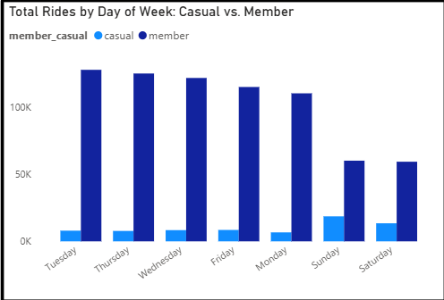
Commute vs. Leisure: Distinct Daily Usage Patterns
Cyclist a fictional bike-share company operating in Chicago. In 2016, Cyclistic launched a successful bike-share offering.
Our marketing director has identified a key business opportunity: understanding the differences between our casual riders and our annual members is crucial for converting casual riders into more profitable annual memberships.
The insights we gain from this analysis will help us develop targeted marketing strategies to achieve our conversion goals.

Slide 8
Key Finding 2: How Long They Ride (Average Ride Duration)

Slide 9
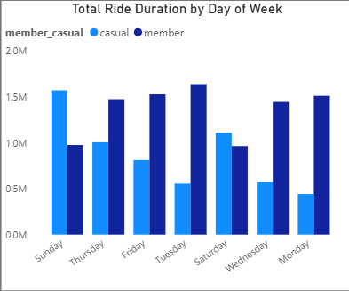
Casual Riders Enjoy Longer Journeys
Beyond when they ride, our analysis also reveals a significant difference in how long casual riders and annual members use Cyclistic bikes.
Looking at the chart, it's clear that casual riders (in light blue) consistently accumulate a much higher total ride length across most days of the week, with noticeable peaks on weekends.
Casual riders appear to be using Cyclistic for more immersive experiences or longer recreational outings, as opposed to quick point-to-point travel

Slide 10
Key Finding 3: Where Journeys Begin (Station Preferences)

Slide 11
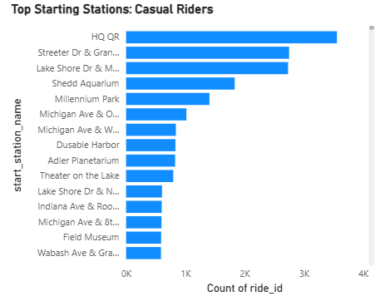
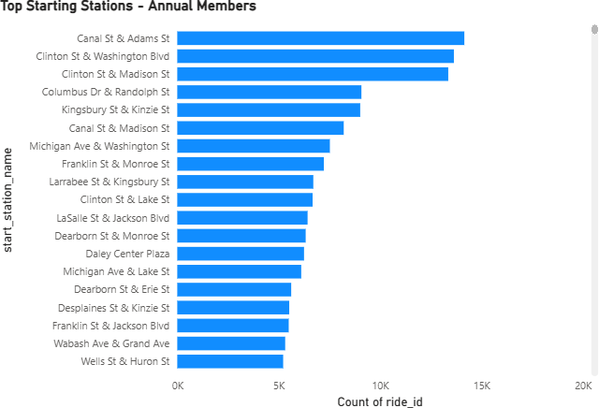
Different Destinations, Different Riders
As we can see from the chart on the right, casual riders frequently start their trips from stations located near prominent tourist attractions, recreational areas, and landmarks such as HQ QR, Streeter Dr & Grand Ave, Lake Shore Dr & Monroe St, and Shedd Aquarium."
In contrast, the chart on the right shows that annual members' most popular starting stations are typically found in dense business districts, residential areas, and near public transportation hubs, including Canal St & Adams St, Clinton St & Washington Blvd, and Kingsbury St & Kinzie St.

Slide 12
Recommendations:Influencing Casual Riders to Become Members

Slide 13
Actionable Strategies for Conversion
Implement focused marketing efforts directly at top casual rider starting stations located near tourist attractions, parks, and cultural landmarks (e.g., Shedd Aquarium, Millennium Park, Streeter Dr & Grand Ave).
Develop digital media campaigns that clearly articulate the cost-effectiveness and seamless convenience of an annual membership compared to repeated casual passes.
Introduce flexible membership options that cater specifically to the casual rider's observed usage. This could include discounted weekend-only passes, seasonal memberships (e.g., Spring-Summer Adventure Pass), or tiered plans that reward longer ride durations.
Partner with local businesses (coffee shops, small eateries, gift shops, tourist attractions) located along popular casual rider routes or near their frequented leisure stations (e.g., Shedd Aquarium, Millennium Park, Lakefront Trail entry points).

Slide 14
Conclusion & Next Steps

Slide 15
Conclusion
In summary, our analysis clearly demonstrates that casual riders and annual members use Cyclistic bikes in fundamentally different ways.
Casual riders are primarily leisure-focused users who engage with the service for longer trips, predominantly on weekends, and from stations near tourist attractions."
By understanding these distinct behaviors, Cyclistic can move beyond generic marketing and develop highly targeted strategies that speak directly to the motivations and habits of casual riders.

Slide 16
THANK YOU

